Slide 1
STUDENT NAME: VIJAYALAKSHMI
REGISTER NO AND NMID:212406222/B772ABC4B90CC0FBD06436D4AC783605
DEPARTMENT:BCA COMPUTER APPLICATION
COLLEGE: MANGALAM COLLAGE OF ARTS AND SCIENCE AND MADRAS UNIVERSITY
DIGITAL PORTFOLIO

Slide 2

PROJECT TITLE
Interactive digital portfolio using front end development

Slide 3

Problem Statement
Project Overview
End Users
Tools and Technologies
Portfolio design and Layout
Features and Functionality
Results and Screenshots
Conclusion
Github Link
AGENDA

Slide 4
PROBLEM STATEMENT
Traditional resumes do not capture hands-on experience well. A portfolio website can
demonstrate learning journeys through visuals, timelines, and examples.

Slide 5
PROJECT OVERVIEW
This project is a personal digital portfolio website aimed at enhancing professional presence online. It
allows users to display their career highlights, academic background, and certifications in an organized
manner. Built with a focus on responsiveness and user experience, the portfolio serves as a central hub
for self-promotion.
Key Features:
● About Me: Introduction and background
● Education: Academic history and milestones
● Skills: Technical and soft skills
● Certificates: Achievements and completed courses
● Contact: Simple form for communication or queries

Slide 6
WHO ARE THE END USERS?
Students (academic projects, resumes).Job seekers (to share with recruiters).Freelancers (to show clients).Professionals (to highlight experience and achievements).

Slide 7
TOOLS AND TECHNIQUES
HTML Structure (pages, sections).CSS Styling (colors, layouts, responsiveness).JavaScript Interactivity (navigation menu, animations, form validation)Mention code editor (VS Code) or CODEPEN and hosting platform (GitHub Pages)JavaScript Interactivity (mobile navigation menu toggle)

Slide 8

POTFOLIO DESIGN AND LAYOUT
PORTFOLIO DESIGN AND LAYOUT
• Home
• About Me
• Skills
• Projects
• Achievements
• Contact
• Responsive navigation with hamburger menu
•Responsive layout (mobile ,desktop view)

Slide 9

FEATURES AND FUNCTIONALITY
• Responsive navigation bar with hamburger menu for mobile view
Skills section displayed using simple list
•Certificates section displayed in grid format
• Contact details with email,-phone number
• Footer copyright

Slide 10
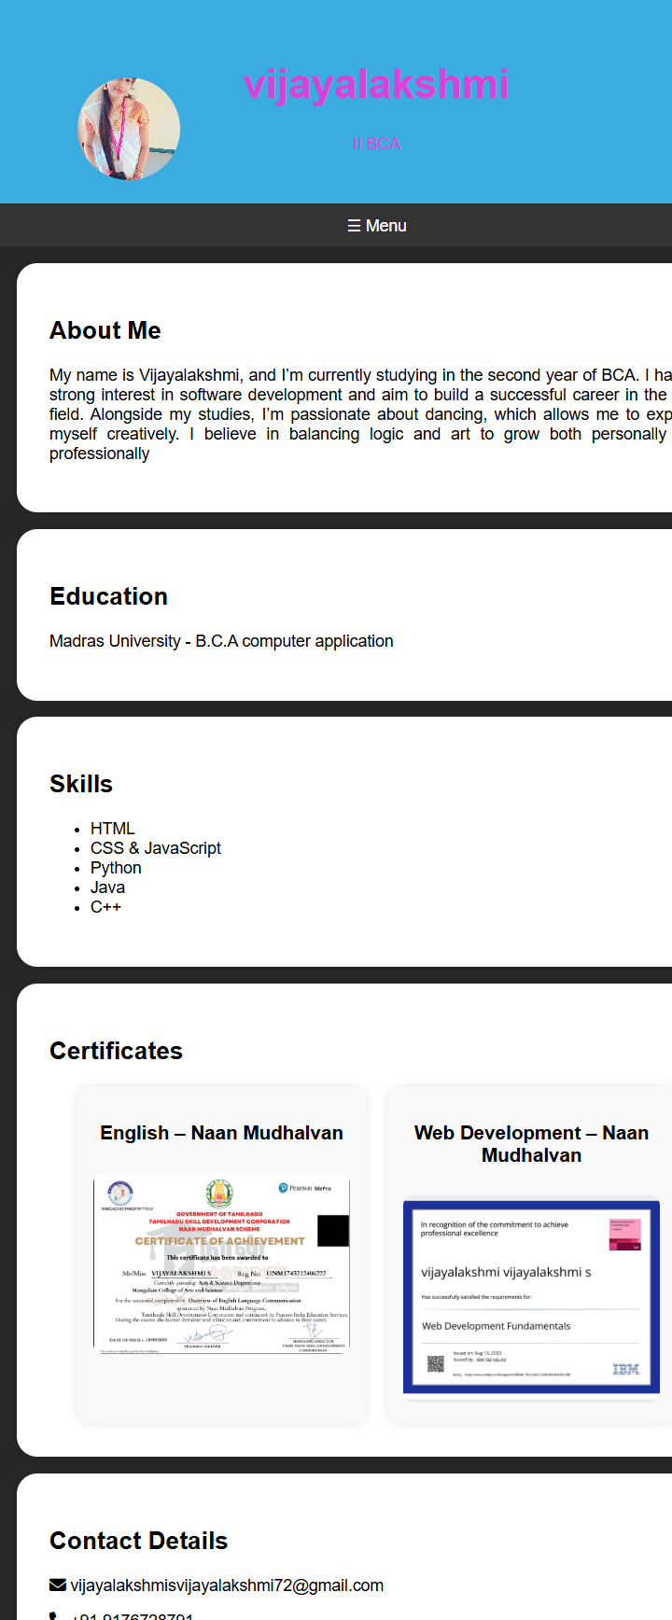
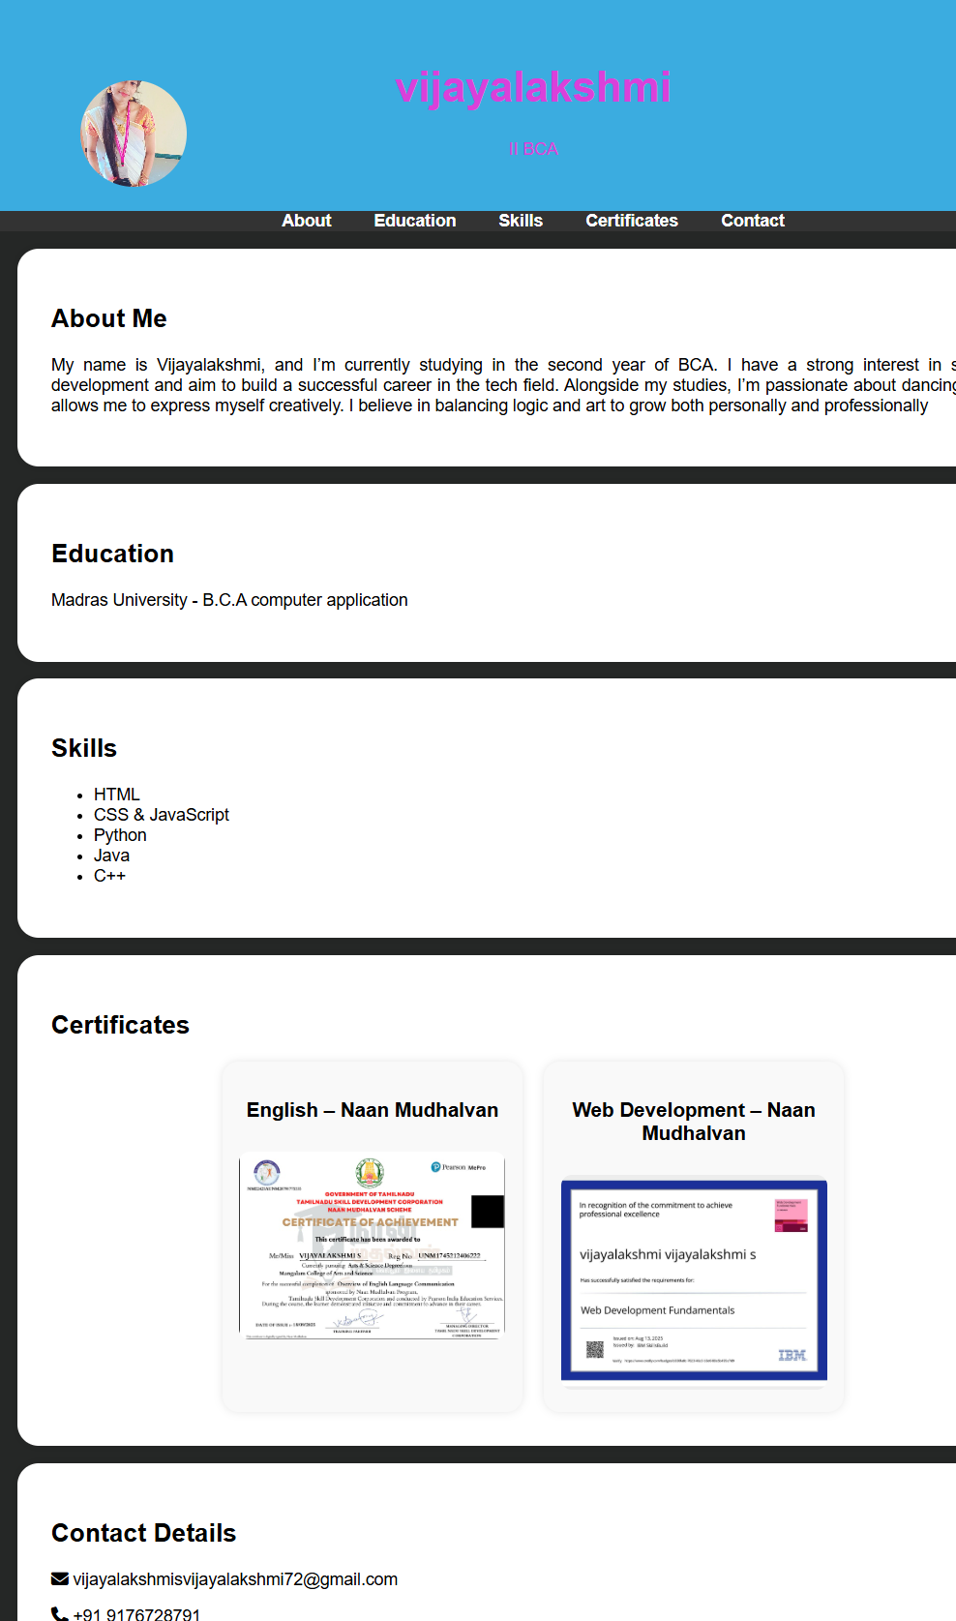
RESULTS AND SCREENSHOTS
Mobile view
Desktop view

Slide 11
CONCLUSION
This portfolio project highlights my journey as a BCA computer application student. It showcases my
interests, skills, and projects in a clean, responsive layout. The site is simple, beginner-friendly, and
functional across desktop and mobile.
Github: https://vijayalakshmisvijayalakshmi72-commits.github.io/s.vijayalakshmi/

